Slide 1
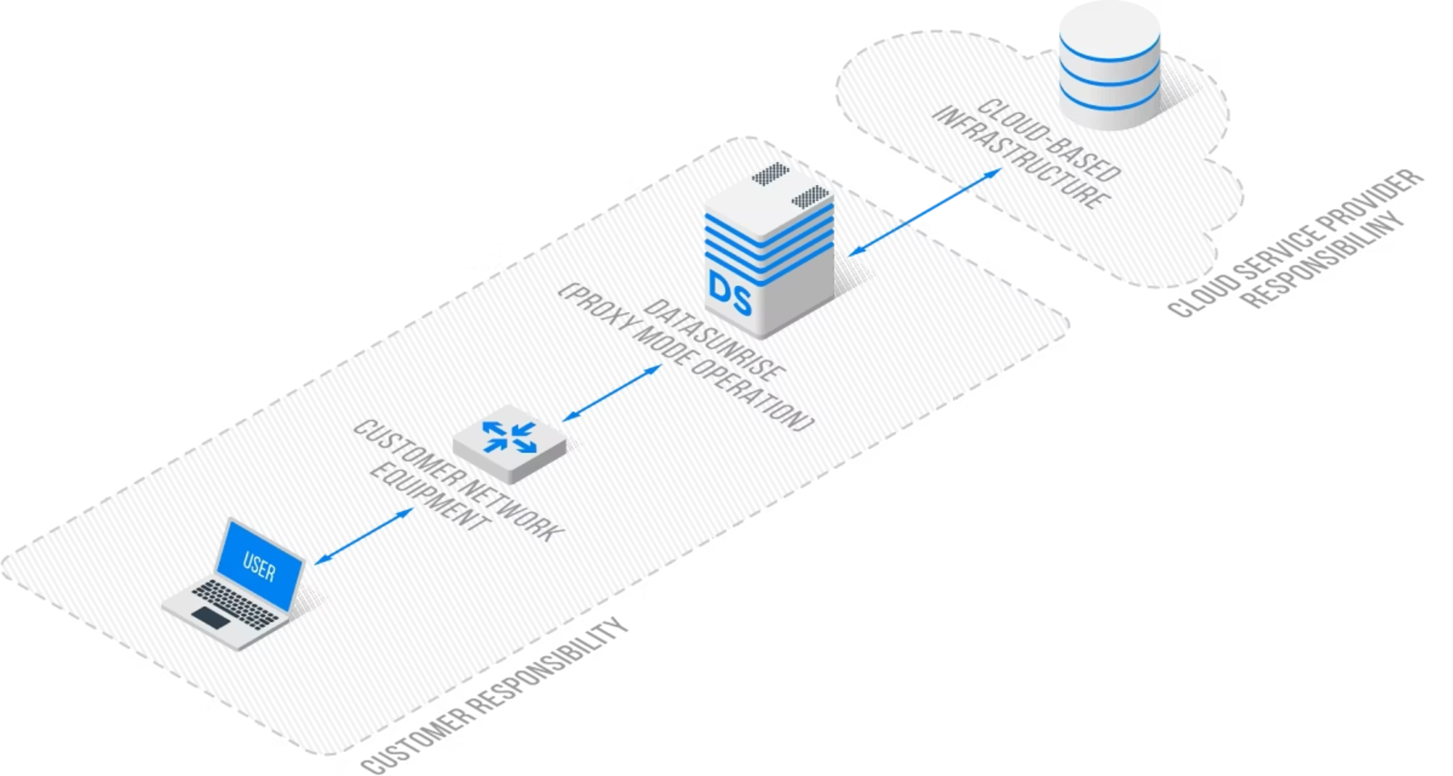
Cloud Center Security: Enhancing Kubernetes Security with Cilium, eBPF, and DDoS Mitigation
Subtitle: A Security-Aware, Predictive Autoscaling Approach
Authors: Zhijun Jiang: NYIT, Vancouver

Slide 2
Motivation
Kubernetes widely used for container orchestration.
Cloud services are increasingly targeted by DDoS attacks.
Current autoscaling: reactive, does not differentiate between legitimate and attack traffic.
Need: security-aware, predictive autoscaling with traffic validation.
Problem Statement
Reactive scaling triggers on all traffic → may scale up for attacks.
Network and security policies lag behind scaling events.
Observability is fragmented → difficult to detect malicious patterns.

Slide 3
Objectives
Enhance Kubernetes autoscaling with security awareness.
Integrate Cilium + eBPF for fast, programmable networking.
Implement DDoS mitigation pipeline.
Enable predictive scaling using ML traffic forecasts.
Provide observability via Hubble + Grafana dashboards.

Slide 4
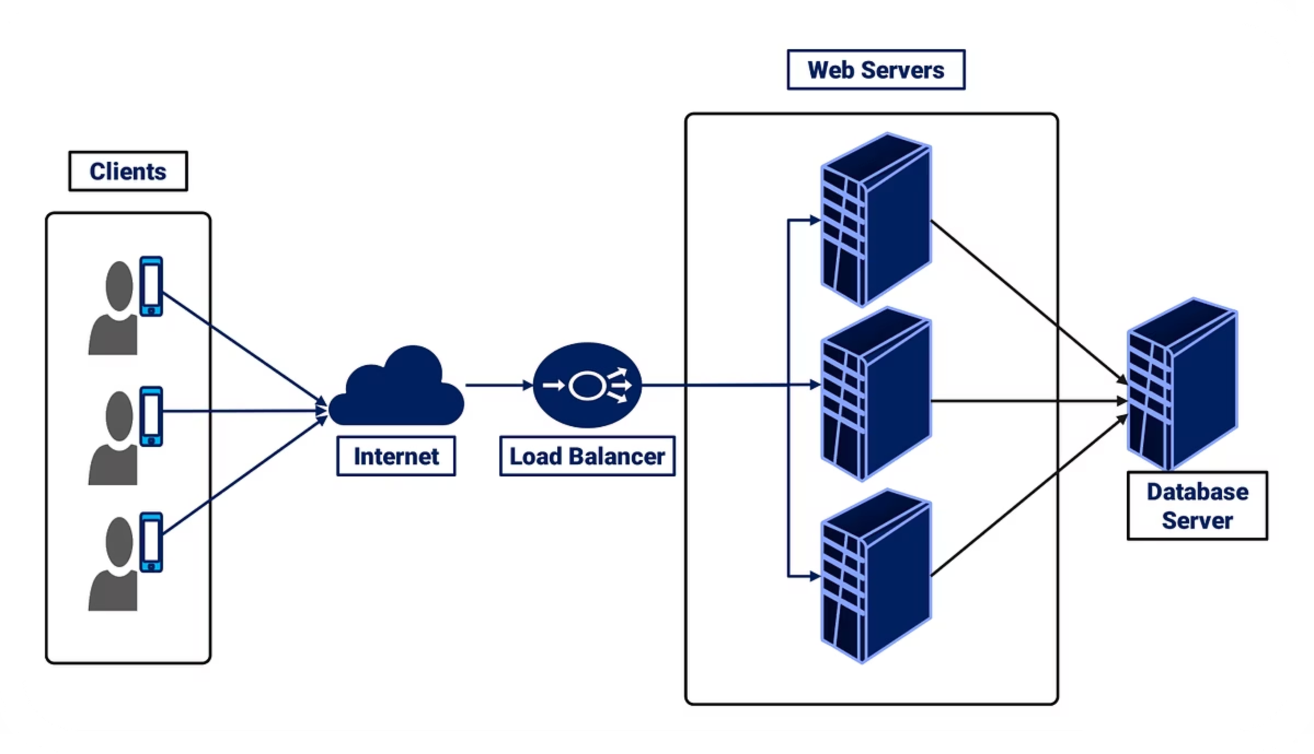
Architecture Overview
Diagram: (Insert corrected TikZ datapath diagram)
Edge Load Balancer / Cloud Scrubber
XDP eBPF pre-filter → drop or rate-limit malicious traffic
Cilium dataplane → enforces L3/L4/L7 policies
Hubble → observability and flow logs
Security-aware autoscaler → ML + Prometheus + policies

Slide 5
Components
Component
Role
XDP / eBPF
Early packet filtering, drops malicious traffic
Cilium
Pod-to-pod networking, policy enforcement
Hubble
Observability, flow logs, metrics
Predictive Autoscaler
Forecast traffic, scale pods securely
DDoS Engine
Attack detection and mitigation actions
DDoS Mitigation Workflow
Traffic enters cluster
XDP pre-filter drops attack traffic
Cilium enforces network policies
Hubble observes flows → sends alerts
Security-aware autoscaler scales only legitimate traffic

Slide 6
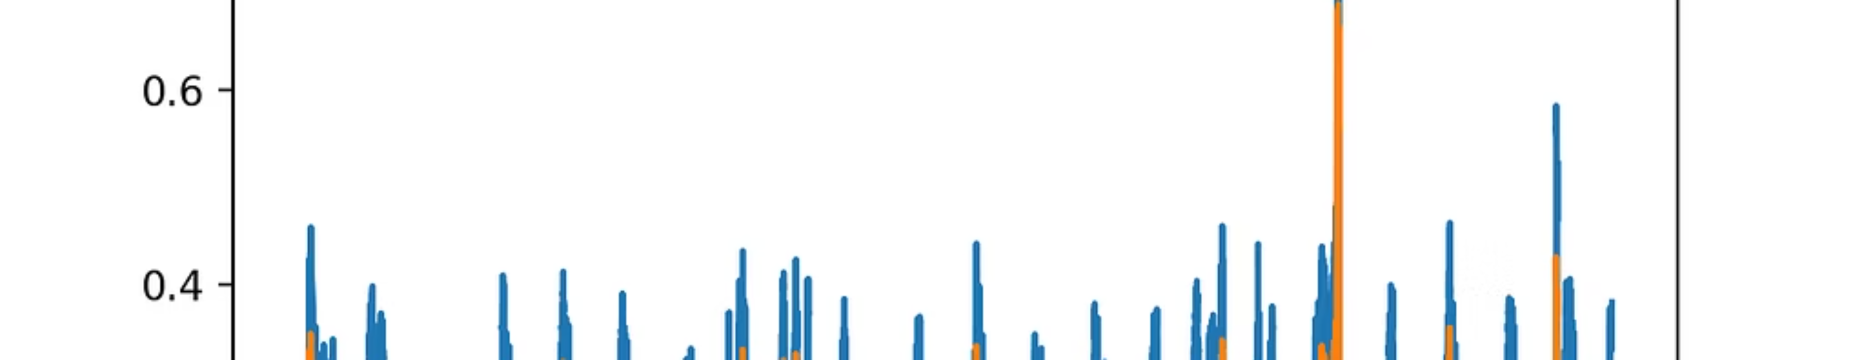

Predictive Scaling Model
LSTM-based time series prediction
Input: last 60 time steps of traffic metrics
Output: next 12-step traffic forecast
Integrates with Prometheus metrics and autoscaler

Slide 7
Key Features
Real-time security-aware scaling
Fast eBPF-based load balancing via Cilium
Observability: per-pod traffic flow, status code tracking
Predictive: anticipates spikes to avoid overloading
Integrated DDoS mitigation

Slide 8

Experimental Setup
Cluster: AWS EKS, 4 nodes (m5.xlarge)
Workload: Go microservice, 5-min startup
Traffic: Vegeta simulated (legitimate + attack mix)
Monitoring: Prometheus + Grafana + Hubble
Autoscalers: KEDA + PredictKube + custom ML controller

Slide 9
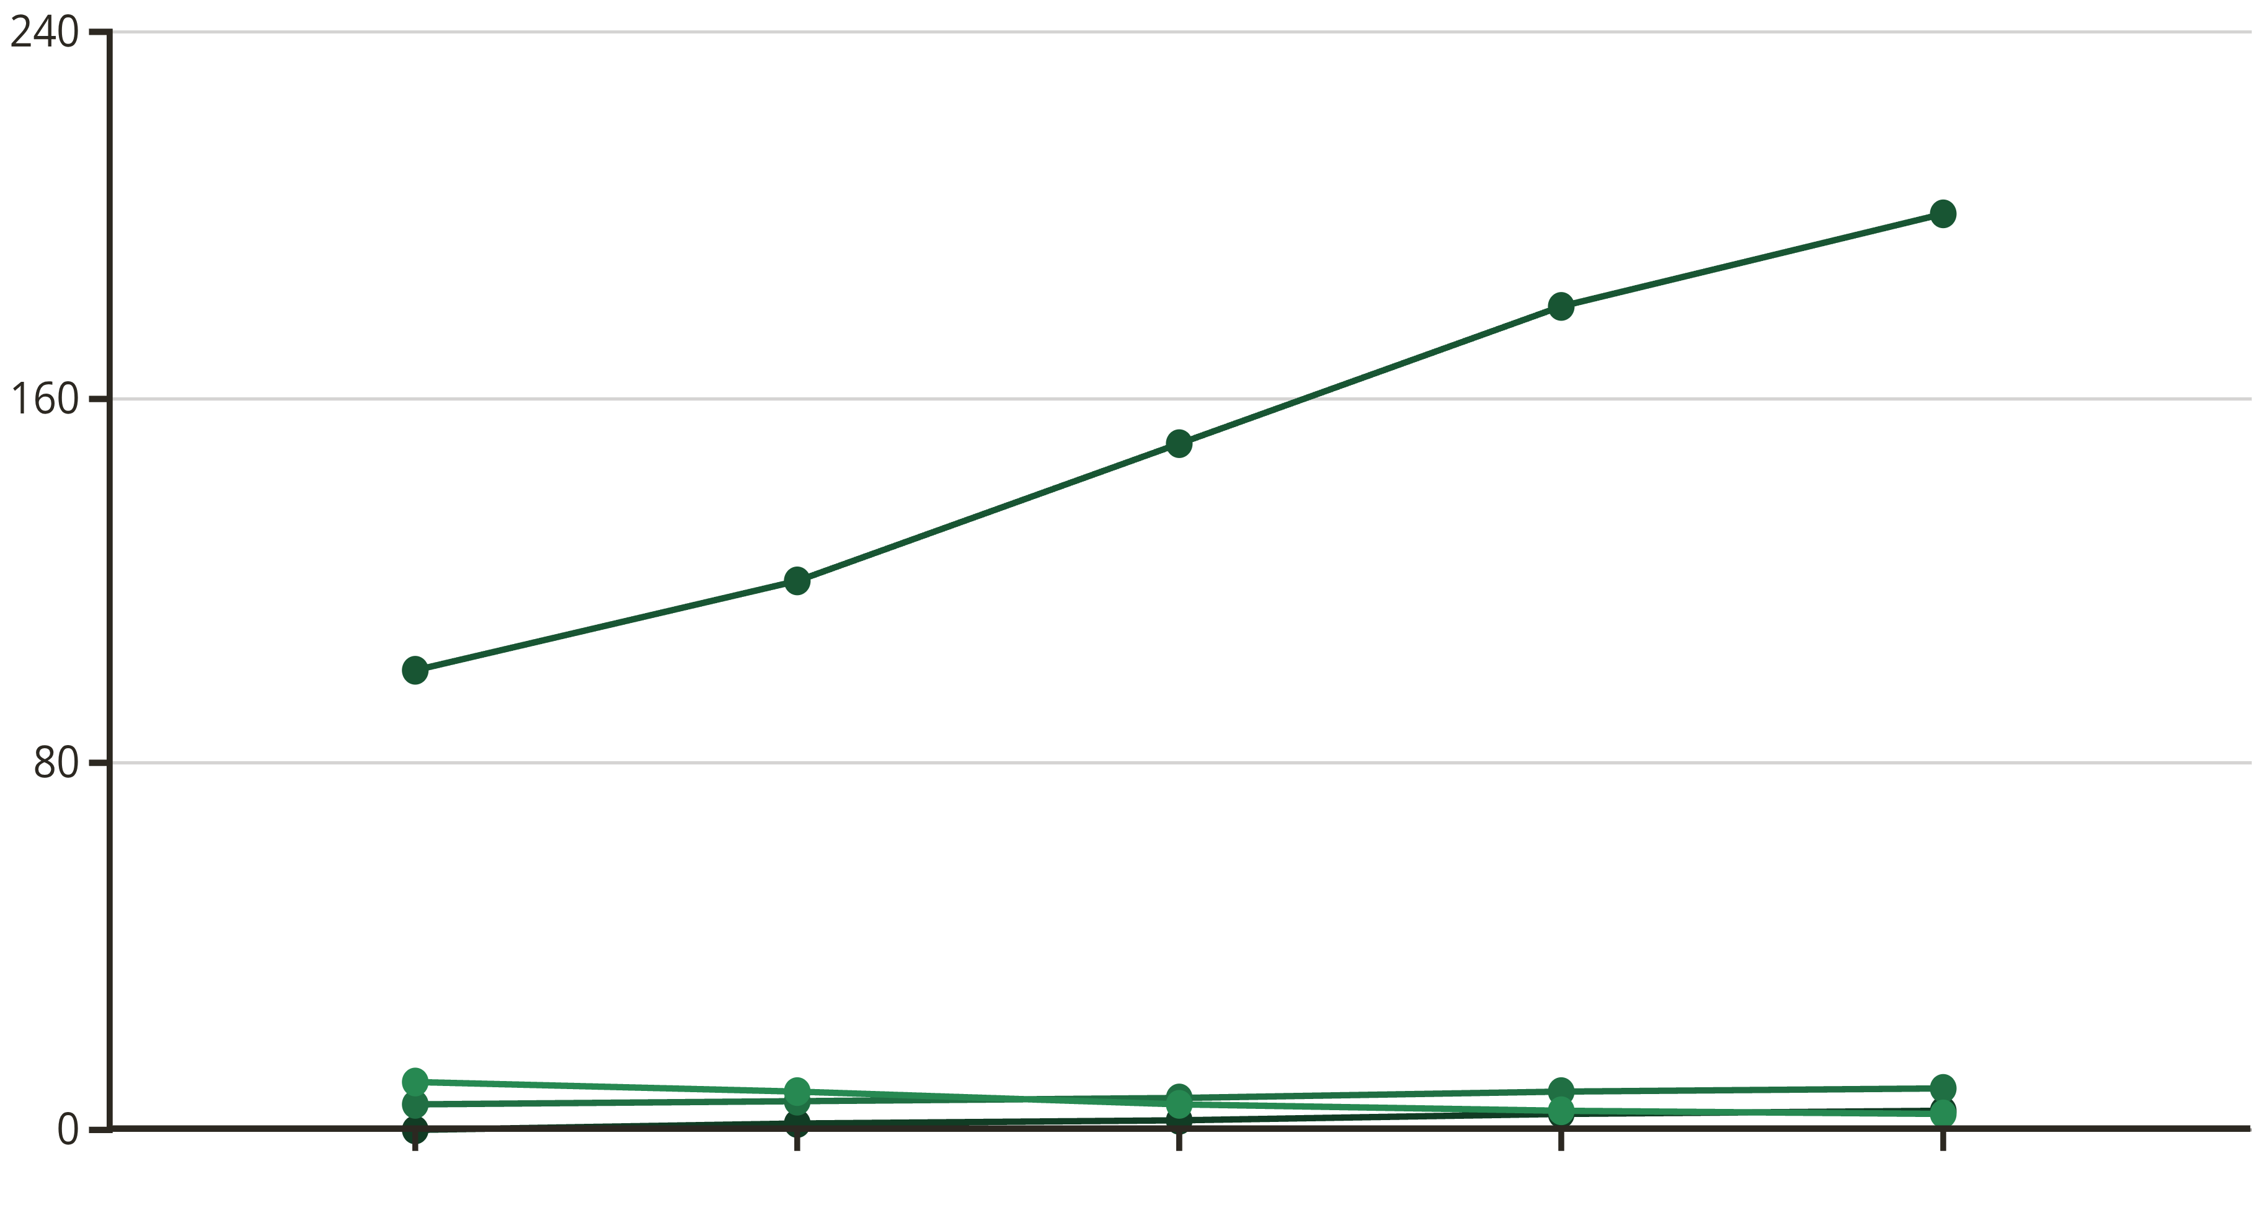
Results: Connection Stability
Connection drops reduced by 72% with Cilium + autoscaler
Predictive autoscaler reduced scaling lag by 54.8%
ML forecast prevented unnecessary pod scaling during DDoS
Time
Requests
Pods
Drops
Results: DDoS Mitigation
XDP pre-filter dropped malicious requests immediately
Cilium network policies restricted attack propagation
Observability via Hubble → real-time flow detection
Traffic Type
Attack Traffic
Legitimate Traffic
Requests Detected
10000
5000
Requests Dropped by XDP
9500
0
Requests Processed by Cilium
500
5000
Pods Scaled
0
5

Slide 10
Related Work
Kubernetes autoscaling: HPA, KEDA (reactive) \cite{keda}
eBPF and Cilium for cloud security \cite{cilium_whitepaper}
DDoS detection and mitigation in cloud \cite{ddos_survey}
Predictive scaling for container workloads \cite{predictkube}
Lessons Learned
Observability is critical → Grafana + Hubble
Predictive scaling improves resource efficiency
DDoS mitigation must integrate with scaling → avoid waste
Cilium + eBPF ensures instant networking convergence
Future Work
Hybrid predictive + reactive security-aware controller
Multi-cloud deployment for resilience
Chaos engineering to test autoscaler under attack
Integrate anomaly detection for novel attacks
Conclusion
Cloud center security requires integrated network + scaling + observability
Cilium + eBPF + ML autoscaler improves performance and mitigates DDoS
Security-aware scaling ensures efficient resource use
Architecture is extendable and observable
References
Kubernetes Event-Driven Autoscaling (KEDA). https://keda.sh/
Cilium: eBPF Networking for Kubernetes. https://cilium.io/
Hubble: Observability for Cilium. https://cilium.io/hubble/
DDoS Attack Detection & Mitigation Survey, IEEE Access, 2022
PredictKube: ML for Kubernetes Autoscaling. https://predictkube.com/
eBPF Literature: “BPF Performance and Applications”, ACM 2020

